Slide 1
Why is it important for water businesses to understand asset criticality?
Moira Zeilinga DIRECTOR - CLEAR IDEA
Qldwater Essentials Webinar #20

Slide 2
Topics to be covered
Same problems exist across Queensland
Finite resources (finance, people and skills)
Targeted and consistent approach
Asset Infrastructure Cliff (Ageing Infrastructure)
Statewide Guideline and Framework
Achieved through knowledge sharing

Slide 3
Water and Wastewater - Qld
Queensland Council’s and Water Utilities operate and maintain water and sewerage infrastructure valued at around $37 billion and provide services to 4.3 million people across 370 communities. Council’s and Water Utilities in Queensland manage around 42,000km of water pipes and 35,500km of wastewater pipes

Slide 4
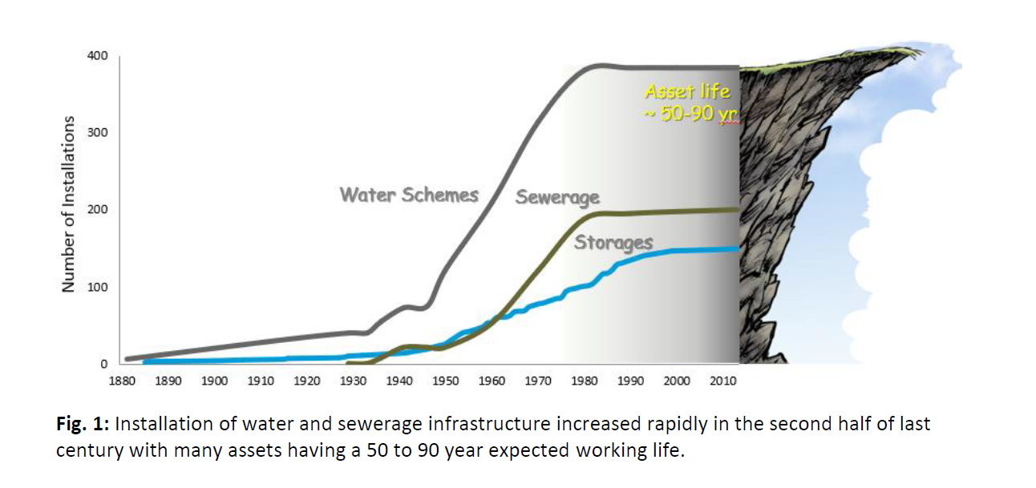
Infrastructure Cliff
Large co-horts reaching end of life
Numerous assets installed 1960-1980’s (end of life at same time)
Potential under-investment in renewals
Ref - Infrastructure Cliff? Queensland’s ageing water and sewerage assets. 1. In-ground network asset lives (2018, R.Cosgrove & R. Fearon)

Slide 5
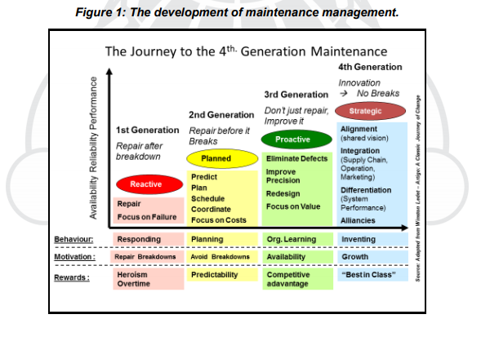
Finite Resources
Drivers:
Budget Constraints
FTE Caps
System Limitations
Asset Maturity Constraints
Skills gaps
How mature is your organisation in asset maintenance?
Ref – GFMAM Asset Maintenance Framework (2016)

Slide 6
Targeted and consistent
Easy to understand
Easy to apply
Aligned to Corporate Risks
Applicable to single or multiple assets

Slide 7
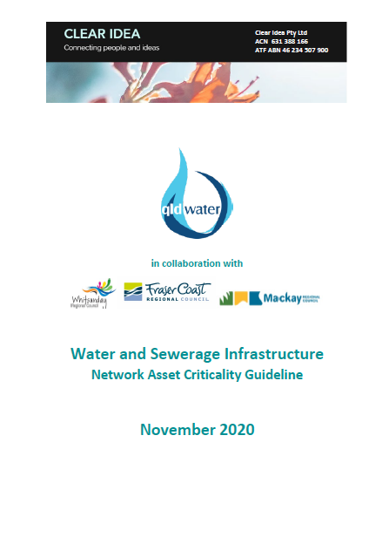
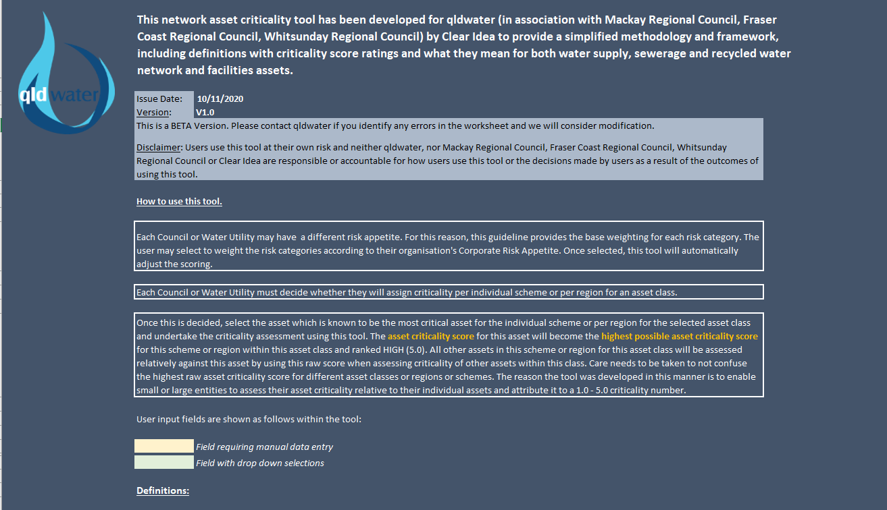
qldwater Statewide Framework
Network Asset Criticality - Collaboration Project to develop Network Asset Criticality Framework (2020)

Slide 8
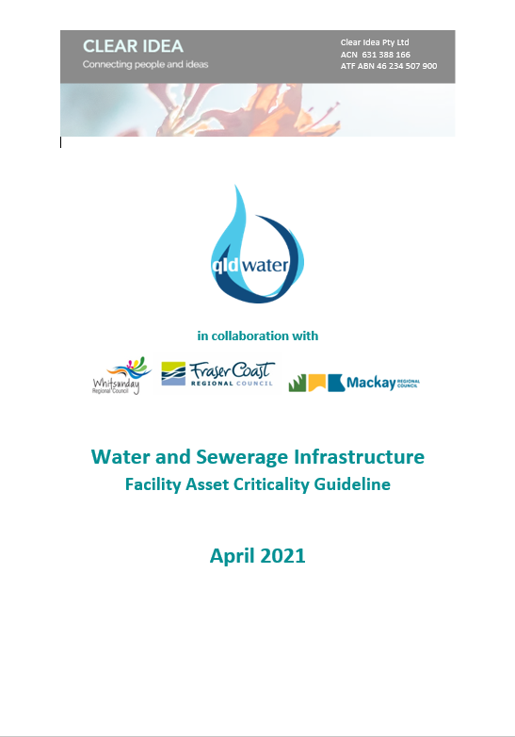
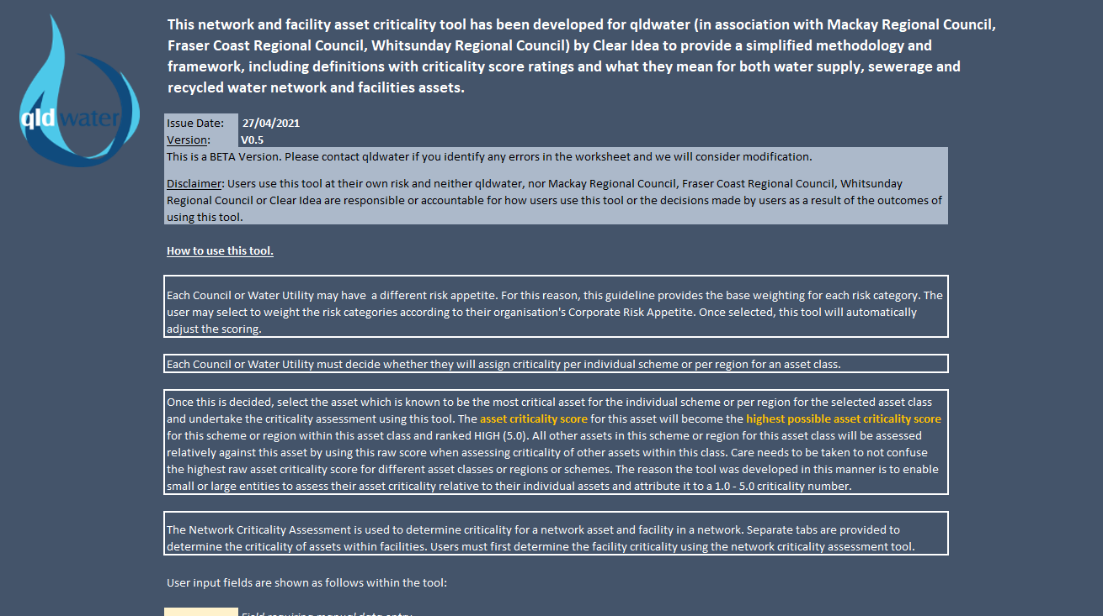
qldwater Statewide Framework
Facility Asset Criticality - Collaboration Project to develop Network Asset Criticality Framework (2021)
DRAFT
DRAFT

Slide 9
What is Asset
Criticality?

Slide 10
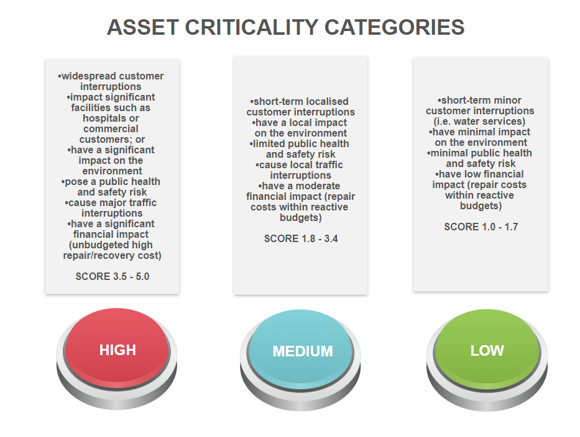
Qldwater FrameworkAsset
Criticality

Slide 11
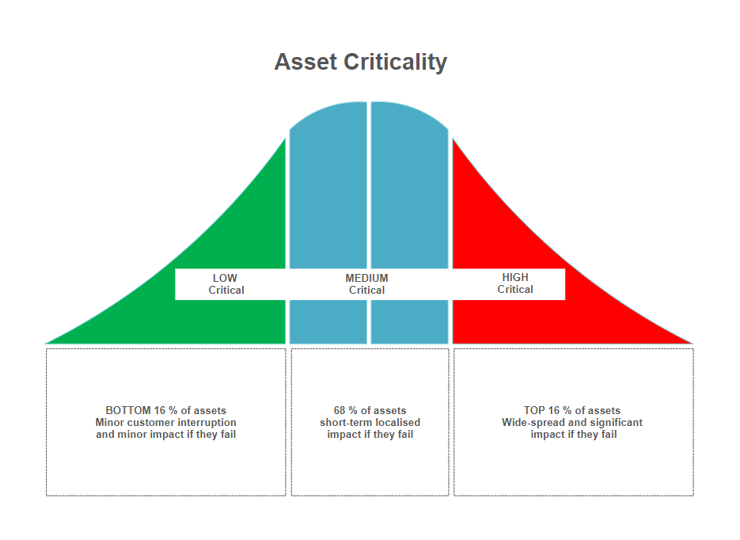
What should you expect?

Slide 12
How to implement?
Frameworks available to members through qldwater
What do you need to make a start?
Budget or dedicated resources
Identify who will be involved
Decide what framework to use and agree on a set of Council specific business rules that will be applied to criticality assessments (you are looking for consistency and repeatability of assessments now and in the future – limit personal judgements as much as possible)
Data collection
Analysts to analyse the information (GIS and Engineering)
Undertake scoring assessments
Validate accuracy of assessment with key stakeholders
Modify assessments based on feedback
Load criticality RANK and NUMBER (1.0 – 5.0) into GIS and AMIS

Slide 13
How will this help your decision making?
EXAMPLES ONLY
Expenditure Activity |  | HIGH CRITICAL | MEDIUM CRITICAL | LOW CRITICAL
OPEX | Operations | Contingency Plan for all HIGH CRITICAL assets Critical Spares or sufficient asset redundancy | Critical Spares or sufficient asset redundancy where appropriate | N/A
 | Reactive Maintenance | 2 HR Response | Same day or next day response – provided customer service not impacted | Days / Weeks – provided customer service not impacted
 | Preventative Maintenance | Avoid failure, Manufacturer PM | Apply risk-based PM i.e. as asset degrades with age or environment, increase inspections to avoid failure | Run-to-fail strategy other than compliance inspections
 | Corrective Maintenance | Repair within 7 days | Repair within 30 days | Repair within 90 days
 | Condition Monitoring | Monitor performance continually | Monitor performance using data analytics and opportunistic material sampling | Monitor performance using data analytics and opportunistic material sampling

Slide 14
How will this help your decision making?
EXAMPLES ONLY
Expenditure Activity | HIGH CRITICAL | MEDIUM CRITICAL | LOW CRITICAL
CAPEX | Compliance | Within 6 months | Within 1-2 years - provided customer service not impacted | Beyond 3 years – provided customer service not impacted
 | Renewals | Within 6 months | Within 1-2 years - provided customer service not impacted | Beyond 3 years – provided customer service not impacted
 | Growth * | Within 1-2 years | Within 3-5 years | Beyond 5 years
 | Improvements | Within 1-2 years - provided customer service not impacted | Within 3-5 years | Beyond 5 years

Slide 15
Sharing Learnings
QWRAP Small/Remote Regional Councils Project
Step change – use the data you have available, and improvements can be made in future or you can collect and improve your data sets as part of the project
Continuous Improvement – Provide feedback to qldwater if you are using the frameworks so everyone can benefit from identified improvements
Asset Data Improvement and Asset Management Maturity is a Journey – start small and expand from there
Empower someone to take ownership of keeping the criticality assessments updated for new assets
Involve your people and use the information to prioritise maintenance and renewals decisions and budgets

Slide 16
QUESTIONS ?

